Slide 1
Improved similarity scores for comparing motifs
Emi Tanaka¹, Timothy Bailey², Charles E. Grant³, William Stafford Noble³,⁴ and Uri Keich¹
¹School of Mathematics and Statistics, The University of Sydney, Sydney, NSW Australia,
²Institute for Molecular Bioscience, The University of Queensland, Brisbane, QLD, Australia,
³Department of Genome Sciences and
⁴Department of Computer Science and Engineering, University of Washington, Seattle, WA, USA
Published May 2011, Bioinformatics
Presented in ACGT group meeting Jul 2011

Slide 2
Modeling Binding Sites
Transcription factor binding sites can be modeled in various ways.
The most popular way is Position Weight Matrix (PWM). This matrix of 4*k represents the TF preference for each nucleotide in each position.
6 | 5 | 4 | 3 | 2 | 1
0 | 0.2 | 0.7 | 0 | 0.8 | 0.1 | A
0.6 | 0.4 | 0.1 | 0.5 | 0.1 | 0 | C
0.1 | 0.4 | 0.1 | 0.5 | 0 | 0 | G
0.3 | 0 | 0.1 | 0 | 0.1 | 0.9 | T

Slide 3
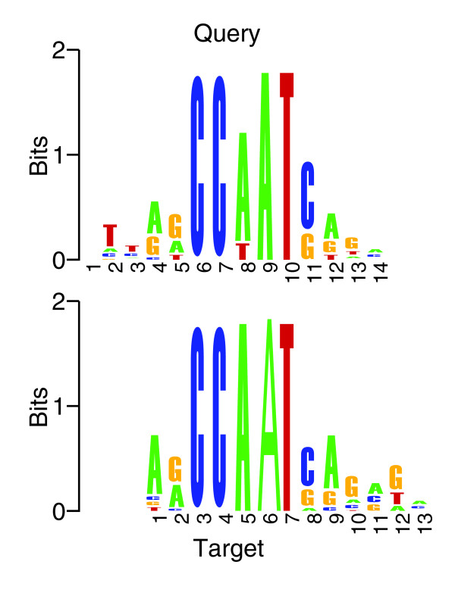
Problem definition
Measure the similarity between two PWMs most accurately.
Example:

Slide 4
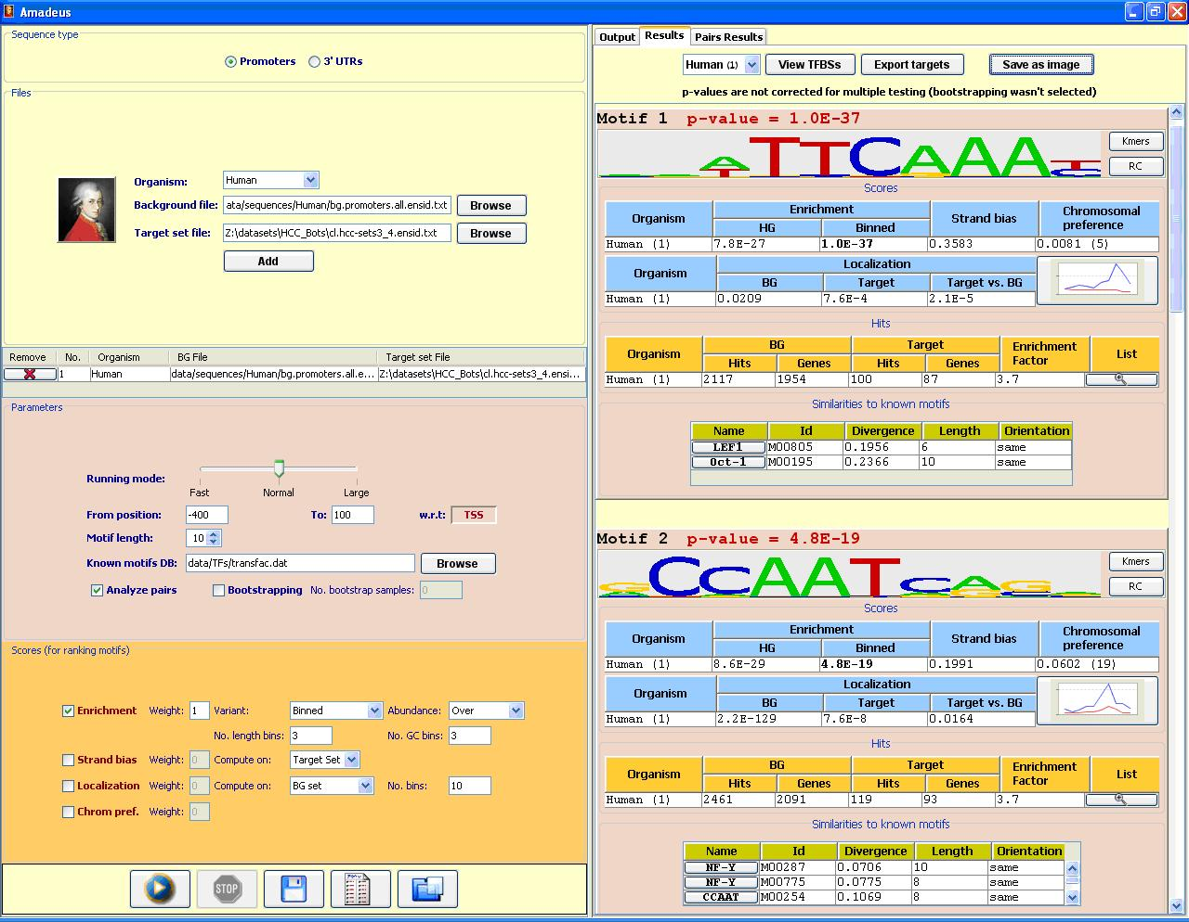
Application Example

Slide 5
Previous methods
A simple method to measure PWM similarity was given in (Harbison et al., 2004):
1. Decide on similarity between columns. For example, Euclidean distance.
2. Align the PWMs without gaps and calculate the average similarity of the columns.
3. Iterate over all possible alignments (with a minimum alignment length) and choose the one with minimal distance.

Slide 6
Similarity between columns
Three examples of similarity scores implemented in Amadeus:
Euclidean distance:
Pearson correlation:
Kullback-Leilbler divergence:

Slide 7
T-reg
A tool developed by Roepecke et al. 05 (Vingron lab).
The shorter matrix is moved along the other and all shifted positions that satisfy the following three conditions are considered.
At least half of the shorter matrix has to overlap with the longer.
This overlap has to be at least four positions long.
The overlapping part of at least one matrix has to have a position-averaged entropy below one.
For each shift, an averaged KL-divergence dissimilarity score is calculated, and the smallest one is used.

Slide 8
Representation of the comparison of two weight matrices
The upper, yellow one is a probability matrix taken from the example MEME file. The lower, blue one is the Jaspar count matrix MA0028 for Elk-1.
The divergence computed by T-Reg amounts to 0.644.
Thin dashed lines indicate the overlapping part. The frames depict the core consensus GGAA of the ETS family of transcription factors.

Slide 9
Drawbacks
There are many more column-column similarity scores, but all have very common drawbacks, mostly many false positives.
These can be easily seen when comparing the logos by eye, and so an improvement is necessary.
In addition, there is a need to calculate a p-value for such a match.

Slide 10
Tomtom
A new approach was proposed by Gupta et al. (from Bailey and Noble’s MEME suite) in the paper Quantifying similarity between motifs (Genome Biology 07).
The method first calculates the distribution of column similarity to all known PWMs, then it calculates the p-value of each column resemblance to gain a more significant similarity score.

Slide 11
Tomtom overview
Estimate the null distribution of scores for each column in a 'query' motif.
Estimate the null distribution of the sum of scores for any range of contiguous columns in the query motif.
Determine whether the motif comparison score between the query motif and a particular target motif is statistically significant.

Slide 12
Computing offset P values
Assume that the motifs are of equal width w, that they lie in the same orientation, and that they have a relative offset of zero.
Assume that columns of the motifs are independent and that our scores can be summed.
The problem is to compute a P value for this summation (‘offset p value’).

Slide 13
Finding motifs in a sequence
They adopt a dynamic programming method to calculate the null distribution of summed similarity scores with respect to the motif Q.
ŝ(Q_{i},a) yields a positive integer score for the similarity of the ith column of Q and the letter a ∈ A.
These integral scores correspond to indices x of an array A defining the desired probability density function (PDF).

Slide 14
How to compute A
A is filled recursively by noting that, if we know the PDF A^{(i)} for matches to the first i positions in Q, then we can calculate the PDF A^{(i+1)}
Where P_{a} is the null probability of letter a. The recursion is initialized with A⁽⁰⁾(0) = 1 and A⁽⁰⁾(x) = 0 for x ≥ 1.

Slide 15
First step: Calculating column similarity
The algorithm proceeds in five steps
For a given motif Q of width w_{Q} and a given collection of target motifs T₁ ... T_{n} whose total width is w_{T}, we compute a w_{Q}-by-w_{T} matrix Γ such that Γ_{i,j} = s(Q_{i},T_{j}) (column similarity).
This matrix constitutes the null distribution for our P value calculation.

Slide 16
Second step: Rescaling Γ
Linearly rescale the values in Γ such that the minimum value is 1 and the maximum is t, where t is the specified by the user (in Tomtom, t = 100).
Then round the values in Γ to integers.

Slide 17
Third step
For each column i in Q and for each possible scaled integer score 1 ≤ x ≤ t, compute the frequency of x in the null distribution of the ith column of Γ.
Where δ(·) is the Kronecker delta function.

Slide 18
Fourth step
The vectors A^{(i)} (1 ≤ i ≤ w_{Q}) contain the null PDFs of scaled, integerized scores for alignment to the first i columns of motif Q.
Initialize a PDF A⁽⁰⁾, A⁽⁰⁾(0) = 1 and A⁽⁰⁾(x) = 0 for x ≥ 1, and then perform the recursion as follows:

Slide 19
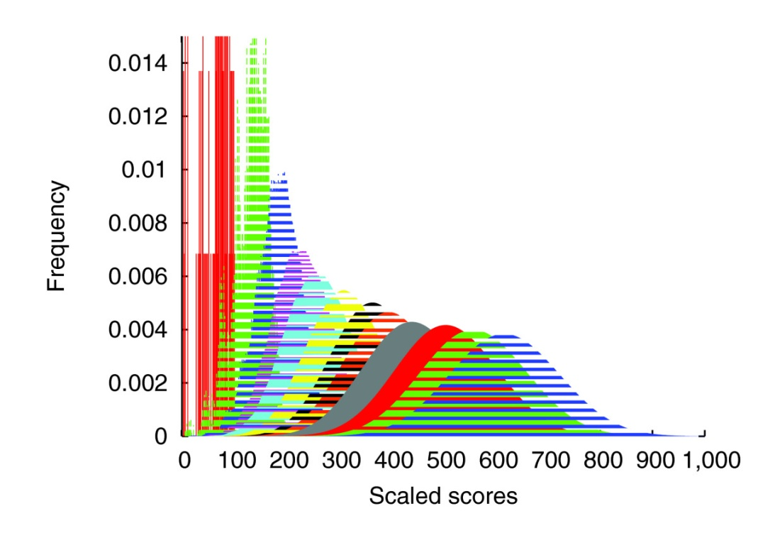
Fifth step
The PDF is converted to a cumulative density function, which can subsequently be used to compute offset P values.
Score distribution histogram for a query motif of length 12. Each histogram contains one more position as we move to the left.

Slide 20
Computing E values
The resulting motif P values must be corrected for multiple tests (the motif query is compared to all motifs in the database).
Tomtom uses a form of Bonferroni correction that assumes that the targets are independent of one another.
The correction consists of multiplying the motif P value by the number of targets in the database.
The result is an E value - the expected number of times that the given query would be expected to match a target as well or better than the observed match in a randomized target database of the given size.

Slide 21
Testing using JASPAR
Begin by selecting all 107 motifs in JASPAR.
Simulate a collection of 10 query and 10 target motifs for each of the JASPAR motifs by subsampling with replacement from the original sites of the JASPAR motif.
If the JASPAR motif has S associated sites, then the query and target motifs are simulated using S/2, S/4, S/8 or S/16 sites.

Slide 22
More technicalities
Eliminate motifs that would yield fewer than two sampled sites, thus leaving 82 JASPAR motifs for the S/8 subsampling experiment.
We trim the edges of half of the motifs in each database. The number of columns to be deleted from a given motif is determined by selecting a random number uniformly from [-0.8w, ..., 0, 0, ..., 0.8w], where w is the motif width.

Slide 23
The task
After this procedure, each motif in the JASPAR database has 10 corresponding motifs in the query and in the target database.
Tomtom's task, given one of the query motifs, is to retrieve all 10 corresponding target motifs with smaller motif P values than any of the unrelated target motifs.

Slide 24
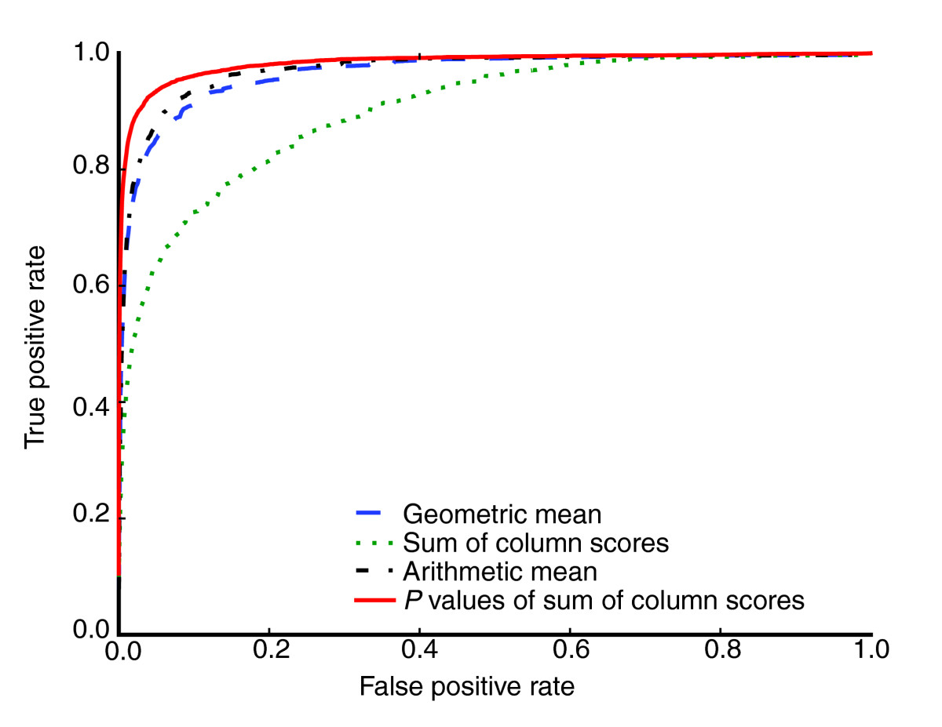
Measuring retrieval accuracy
The figure plots the percentage of correct query-target pairs (true positives) as a function of the percentage of incorrect pairs (false positives)
The solid and dashed lines correspond to width-normalized scores (P values, arithmetic mean, and geometric mean), and the green dotted line represents sum of column scores.
This figure is for Euclidean distance (ED) at a sampling rate of S/8.

Slide 25
A following work
A paper by Habib et al. (Nir Friedman lab): A Novel Bayesian DNA Motif Comparison Method for Clustering and Retrieval (Plos Comp. Biol. 08)
The goal is to determine whether two DNA motifs represent the same binding preferences.
Since the less informative positions in a motif do not contribute to sequence-specific binding of proteins, they developed a similarity score that measures the similarity between two DNA motifs, while taking into account their dissimilarity from the background distribution.

Slide 26
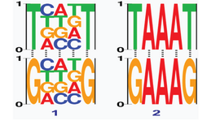
Distinguishing between informative and non-informative positions
Two pairs of aligned motifs are demonstrated, both of which having three identical positions and two different ones.
While the identical positions in the first pair (left) are non-informative, the identical positions in the second pair (right) are informative.
The desired similarity score should distinguish between these two types of similarities and assign a higher score to pair number 2

Slide 27
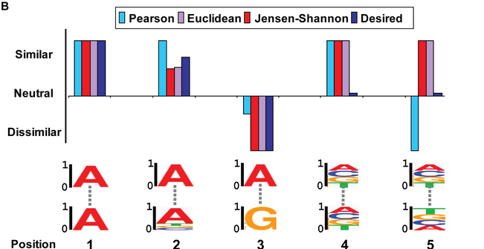
Problematic aspects of motif similarity scores
The similarity score of two position frequency matrices (PFMs) decomposes into the sum of similarities of single aligned positions (position-independence assumption).
All scores (Pearson correlation, Jensen-Shannon divergence, and Euclidean distance) do not reflect the “true” similarity between two distributions or cannot differ between informative and uniform background positions. Specifically, position 4.

Slide 28
Bayesian Likelihood 2-Component score
Composed of two components: the first measures whether the two motifs were generated from a common distribution, while the second reflects the distance of that common distribution from the background.
The score for comparing motifs m₁ and m₂ is:

Slide 29
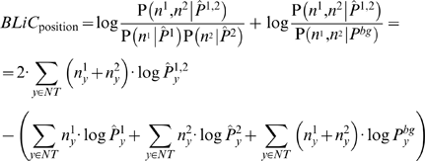
The likelihood-based score measures the probability of the nucleotide counts in each position of the motif given a source distribution.
For two aligned positions in the compared motifs, let n¹ and n² be the corresponding positions (count vectors) in the two motifs, the similarity score is then:

Slide 30
are the estimators for the source distribution of n¹, n² and the common source distribution, respectively, P^{bg} is the background nucleotide distribution, and NT = {A,C,G,T}.
They used a five-component mixture prior, with four components representing an informative distribution, giving high probability for a single nucleotide: A, C, G, or T. The fifth component represents the uniform distribution.

Slide 31
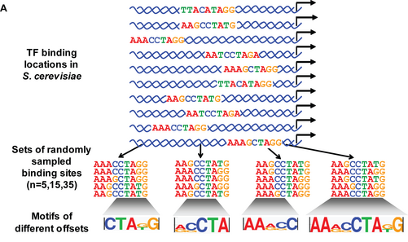
Generating the test data set
They generate motifs by randomly sampling subsets of genomic binding sites, aligning them, and then truncating the resulting motif.
By repeating this procedure, slightly different sets of binding sites were built for each factor.
9 TFs, 240 motifs for each.

Slide 32
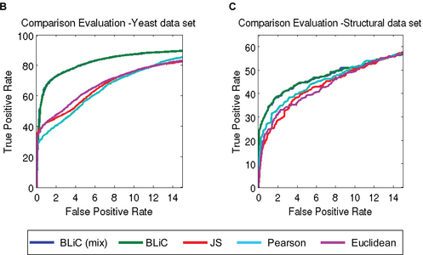
Sensitivity and specificity of different scoring methods
Comparison of different scoring methods on the “Yeast” data set using a subset of motifs generated from subsets of size 35 with altered lengths (not including the full length motifs).

Slide 33
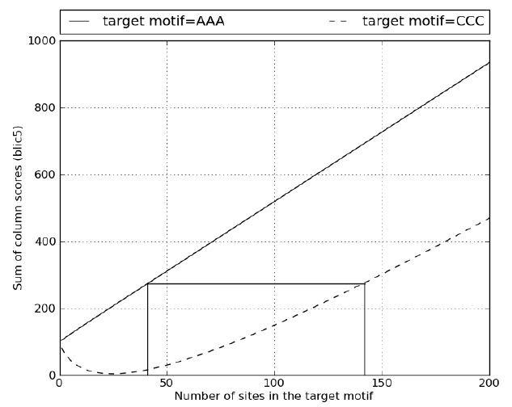
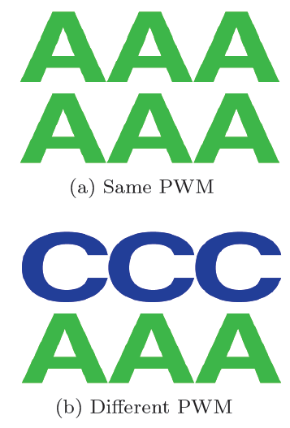
What is wrong with BLiC?
The similarity part in BLiC is negligible when number of sites of the target motifs increase:

Slide 34
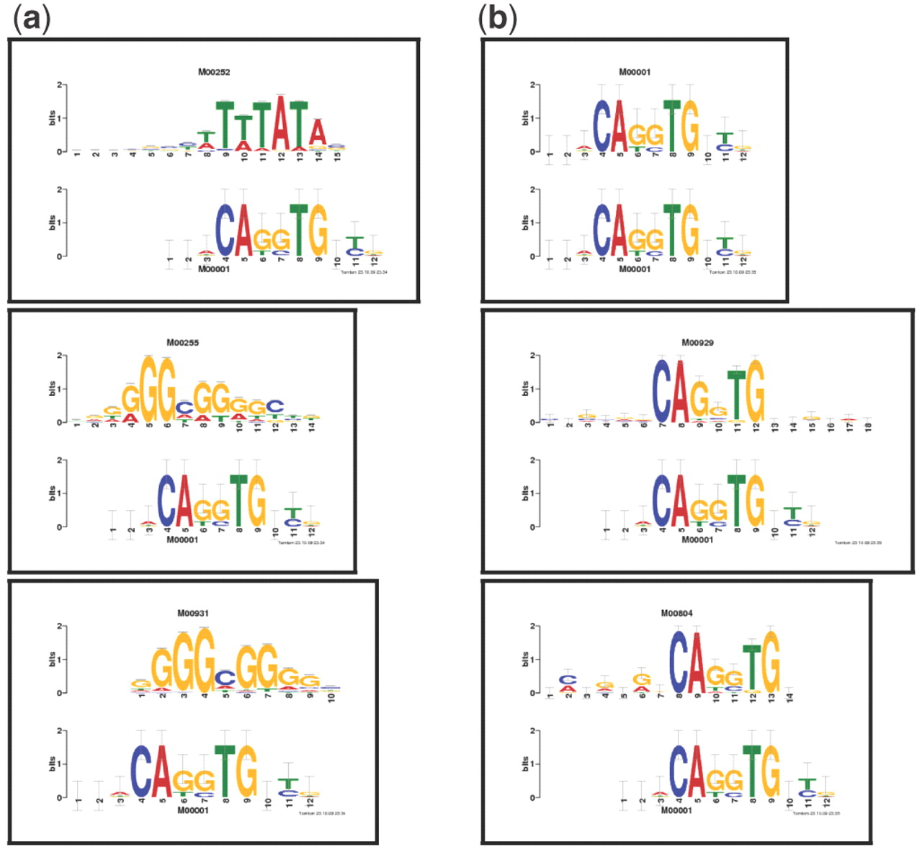
In practice
Top three TRANSFAC hits to the query TRANSFAC motif M00001. The top three TRANSFAC alignments Tomtom found in response to the query TRANSFAC motif M00001 using BLiC (a) and ED (b) similarity scores.
The top three target motifs for the BLiC score have 389, 274 and 235 sites, respectively.

Slide 35
The new scoring scheme in Tomtom
Assign scores to unaligned columns: instead of 0, the median of aligning the column to all columns in the target. This way uninformative columns contribute less.
S_{c}(Q_{i}, ∅): = m_{i} (was 0 before)
m_{i} is the median score of randomly aligning a target column to Q_{i}
The alignment score (new complete score):

Slide 36
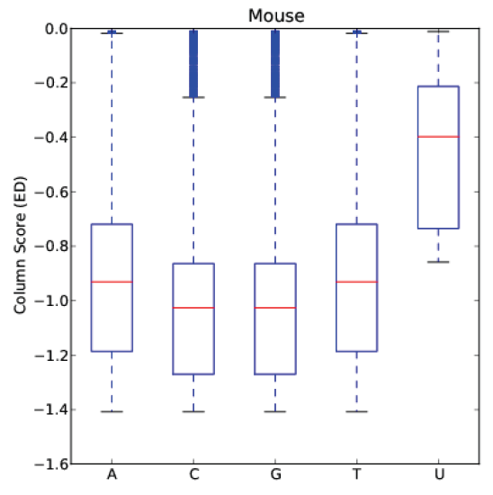
Column score distribution
Boxplots of the null alignment column scores of five different columns:
All-A, all-C, all-G, all-T and a uniformly distributed column.
The column similarity score is ED, and T, the set of null database columns, is derived from the mouse PBM database.

Slide 37
Significance Assessment
Select the best alignment based on its complete score (instead of offset p-value).
Compute the distribution of the maximal of all possible latticed alignment scores. Find the distribution of this maximum using DP approach.
Assign a P-value to the optimal complete alignment score.

Slide 38
P-value
Select a random motif from the mouse PBM database and then query it against a random shuffle of the columns of the remaining 385 motif in the database, while keeping the distribution of database motif lengths unchanged.
Repeating this process 1000 times produces a sample of 385,000 null DP-computed p-values.

Slide 39
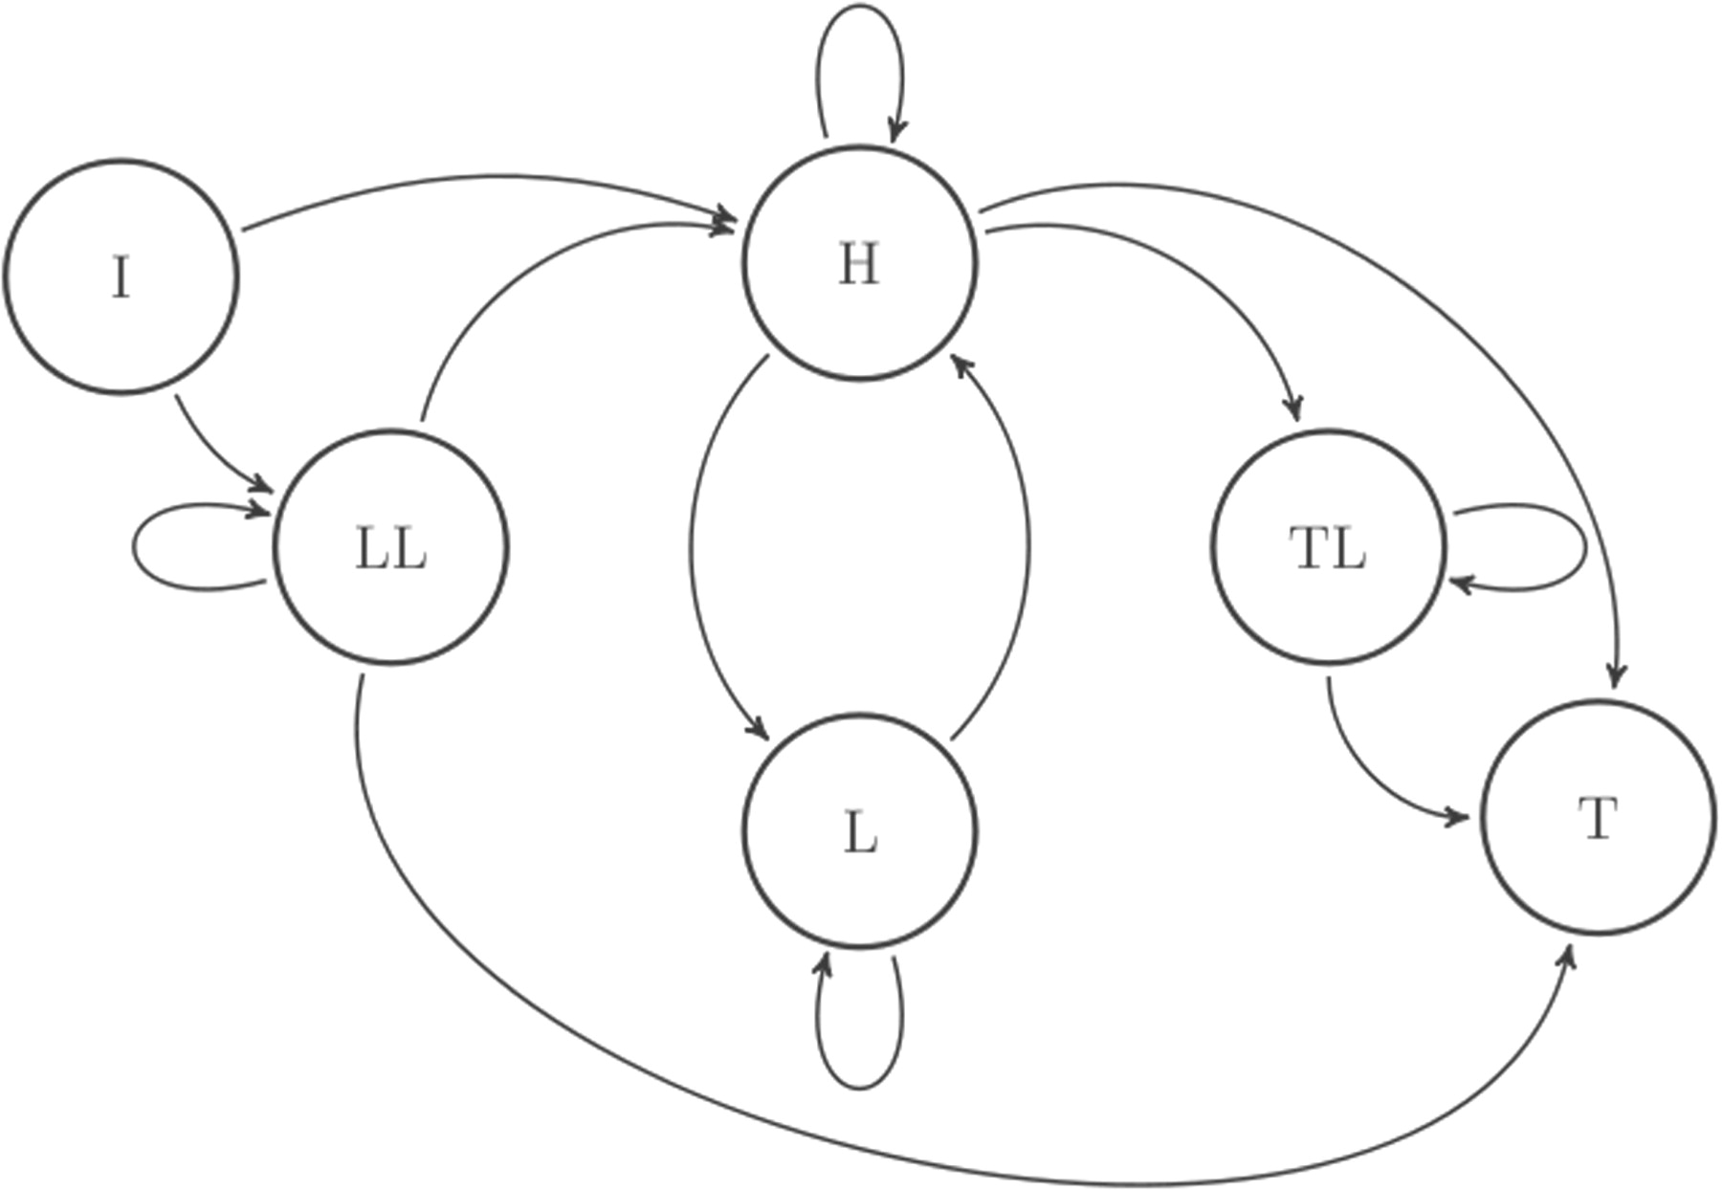
Another way to asses significance: Topology of the null target motif HMM
The LL (leading), L and TL (trailing) states emit low information content columns before, within and after the ‘core’, respectively. The H state emits columns with high information content. The I and T state are the silent initial and terminal states, respectively.
This model better captures the tendency of uninformative columns to cluster than the independent-position model

Slide 40
Training the model
A cutoff of 0.5 was used to determine whether a column has a high or low information content.
Using this cutoff, unambiguously label each motif in the reference database, i.e. infer the hidden states.
A simple maximum likelihood estimation was used for estimating the transition probabilities, while the column emission distributions were set to the observed empirical distributions of each state.

Slide 41
Using the HMM
The HMM is used to estimate the significance of an optimal query–target match through a Monte Carlo (MC) sampling scheme.
The HMM is used to generate N random motifs of exact length |T| (target motif length), and find the optimal alignment score for each.
This procedure gives a sample of size N from the null distribution of the optimal query–target match score (conditioned on the given query as well as on the target length).
The derived empirical distribution can be used to assign a P-value for the observed match score.

Slide 42
Experimental details
Randomly select from the mouse PBM database 80 motifs which will serve as templates for generating randomized queries of the same width w as that of the template motif.
Each randomized query is generated by first setting the number of sites, N, to 5, then 10 and then 20. Then, each of the w columns of the template motif PWM is associated with a Dirichlet distribution on ℝ⁴ parameterized by the vector obtained from multiplying the column's frequencies by N.
Sample each column of the randomized query from the corresponding Dirichlet distribution.

Slide 43
Adding variations
Add variation to these motifs by varying the ‘coverage’ of the sites.
Either take the full site or remove up to 0.3w columns from a randomly chosen end of the motif.
The number of columns to be removed and which end to remove it from are chosen uniformly.
Add additional noise to some of the query motifs by either adding an informative column for motifs with full sites or adding 1 or 3 uninformative columns at an end of a motif that was not previously truncated.
This process yields a total of 1680 motifs to query against the target of the mouse PBM database.

Slide 44
Comparison of several target functions in terms of reduction of uninformative alignments and retrieval accuracy
Column score | Optimal alignment selection (p-value < 0.05) | Overall (motif) P-value | Uninformative alignments at FPR of 5% | Mean AUC
ED | iid offset P-value | ind alignments (TT) | >22.9 | 0.9994
PCC | iid offset P-value | ind alignments (TT) | >24.9 | 0.9994
KLS | iid offset P-value | ind alignments (TT) | >22.1 | 0.9997
SW | iid offset P-value | ind alignments (TT) | >23.3 | 0.9995
ALLR | iid offset P-value | ind alignments (TT) | >6.2 | 0.9984
ED | HMM offset P-value | HMM (MC) | >13.7 | 0.9754
Complete-ED | Motif score | HMM (MC) | < 0.1 | 0.9869
Complete-ED | Motif score | iid (MC) | < 0.1 | 0.9791
Complete-ED | Motif score | ind alignments (DP) | < 0.1 | 0.9994
Complete-PCC | Motif score | ind alignments (DP) | < 0.1 | 0.9994
Complete-KLS | Motif score | ind alignments (DP) | < 0.1 | 0.9996
Complete-ALLR | Motif score | ind alignments (DP) | < 0.1 | 0.9985

Slide 45
ALLR score
One observation is that the Average Log Likelihood Ratio score can differentiate between informative and uninformative alignment.

Slide 46
To conclude
A new method Tomtom for similarity score and calculating the p-value for a motif match.
This new method gave the same weight for unifnormative and informative alignments.
A correction was suggested by BLiC score, but it wasn’t correct for a large number of sites.
A new approach was proposed, taking into account the uninformative columns.

Slide 47
To conclude 2
The complete scores exhibit negligible loss or indeed some gain in retrieval accuracy.
There is a slight decline in retrieval accuracy when using the more sophisticated HMM, when compared with the iid model.
The complete scores assign the median of the null target column similarity score to each unaligned column.

